Slide 1
Name | James
Git Hash | b02f5a313f43e511992a9f2618782f5ab49d2391
Sprint number | Start date | end date | Work hard rating
2 | 4/04 | 15/04 | 2/5

Slide 2
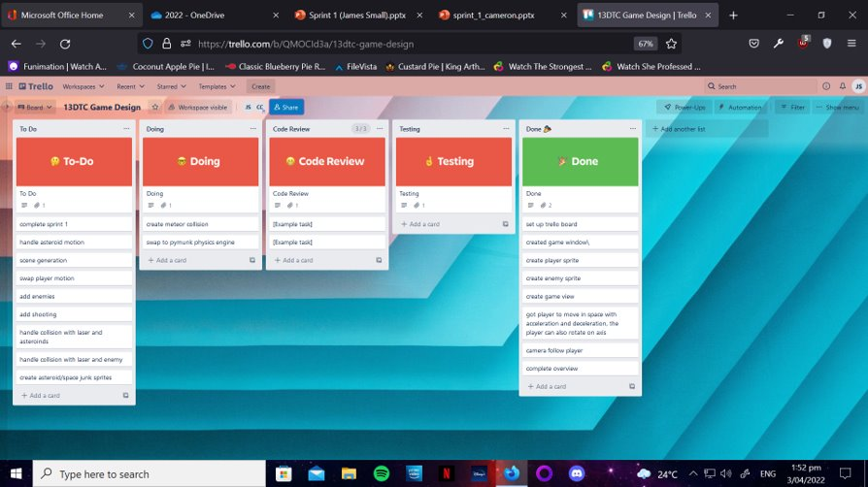
KANBAN board at the start of the sprint

Slide 3
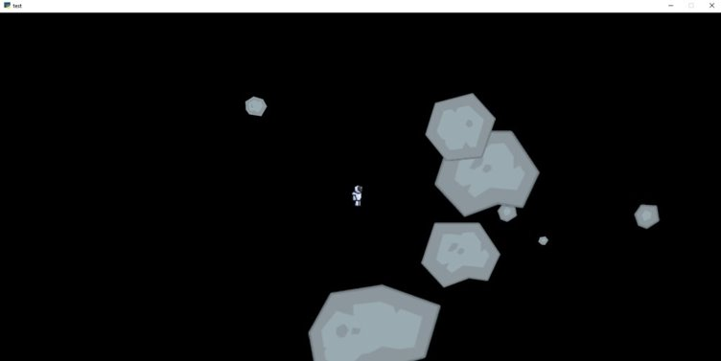
Screenshot of the game at the start of the sprint

Slide 4
Sprint Reflection and summary
I think that the work I did on this sprint was very minimal and that i could've have done better.
I started to research and learn the Pymunk Physics engine on how it operated and how i could integrate it into the game for the player to move and contact meteors and enemies, make it so meteors can contact other meteors crashing and ricocheting off each other in a realistic way. However, I found Pymunk very confusing and complex to use in the game and it took the entire sprint to learn and test it watching many videos on it and learning through arcade academy. I tried to quickly to integrate it into the game without understanding it fully and i ran into lots of problems with me not supplying enough parameters or not using it in the right way with arcade and other code, ultimately i believed the way i approached it slowed the whole process of using pymunk down, this showed me that i should look at the problem overall and try and learn it full before putting it into the game making me learning take the whole sprint without it being in the game.
On the second week of sprint 2 i came down with Covid 19 meaning i was unable to make any progress in the other half of the sprint, this showed me to not rely on my health in completing the whole sprint and that i should plan for this because i wasn't able to complete the task i set myself at the start of sprint 2.
Overall due to my bad way at approaching pymunk and that i got covid i believe i couldve done better on how i approach a sprint and carry out the task within it and i should do better in the future.

Slide 5
Briefly describe other team members contributions
It took cameron the entire sprint to complete this, but it was a large and important task to complete, he was able to get the enemy sprites to spawn in the game which are a key aspect of the games mechanics and overall purpose for the game's existence, he was able to get them spawn randomly spawn over the players screen but not outside that area. I believe he did the best out of us in sprint 2 and was able to make huge advancements for the game towards its ability to function as intended.

Slide 6
Major Changes and Achievements Described
Enemies were added to game and spawn in at different coordinates over the player's screen within a barrier that didn't allow them to spawn outside of the view of the player in the world to not make unesasary enemies which would slow thew game down. This is the only major change that happened to the game.

Slide 7
Brief Description of your testing
To test the enemy spawning function, we would run the game and see where they spawned and whether they were within the coded range they were meant to be in and that they didn't slow the game down, we found that they were, and the enemy spawn function is testing add was fully allowed in the game.

Slide 8
Link to testing results/tables

Slide 9
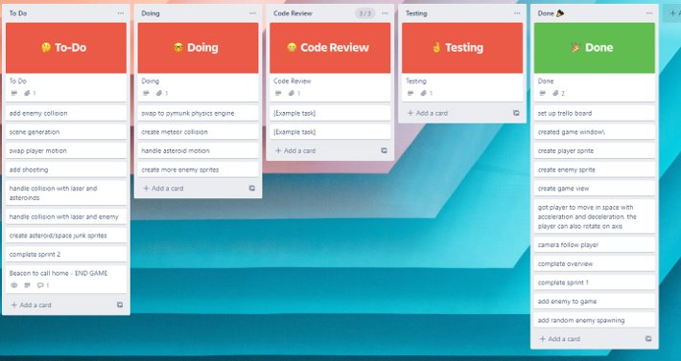
KANBAN board at the end of the sprint

Slide 10
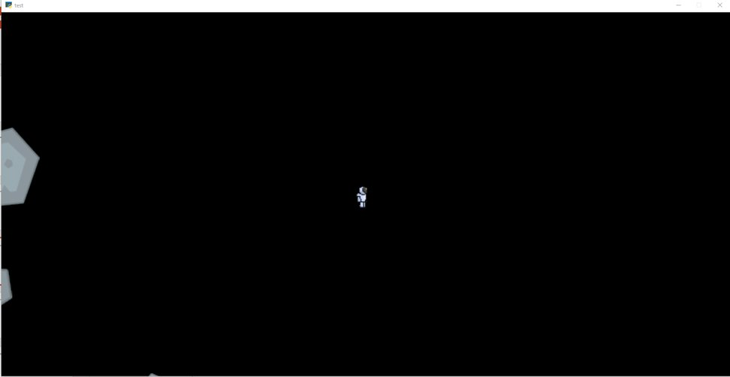
Screenshot of the game at the end of the sprint

Slide 11
Video of the game at the end of the sprint
Same video as sprint 1 due to branches not being pushed to master so game wouldn't work

Slide 12
Notes for next time, future improvements
This sprint for me was slow and not well done, i badly started to look at pymunk and then became ill shortening the time i was able to spend on the game in this sprint. For future improvements i should plan for unexpected absences from the game due to illness or other reasons and i should also approach new areas needed for the game more cautiously so that i don't make the mistake of underestimating things like pymunk. The game has a long way to go and next i would like to finish
Pymunk and integrate it into the game fully allowing things to move within it.
We should also create a meteor sprite to replace the testing ones and spawn them into the game at random locations
Give the enemy the ability to move around the map while avoiding asteroids and targeting the player.

